Slide 1

Wave energy absorption using flexible air-filled bags
Adi Kurniawan
aku@civil.aau.dk

Slide 2
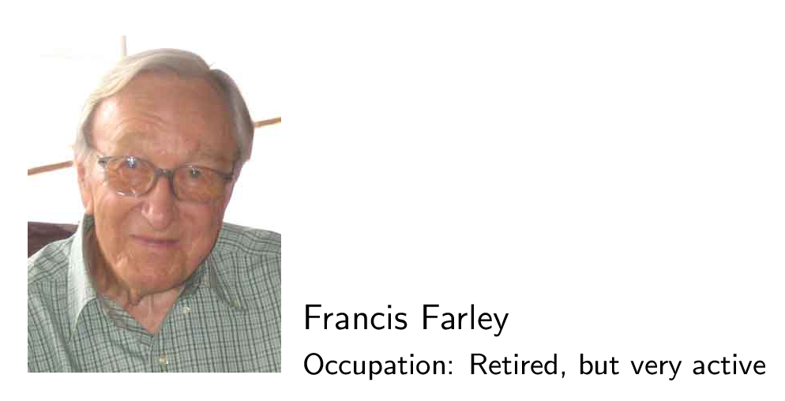
(1920—2018)

Slide 3
Salter
Farley
Evans
Falnes

Slide 4
Triplate

Slide 8
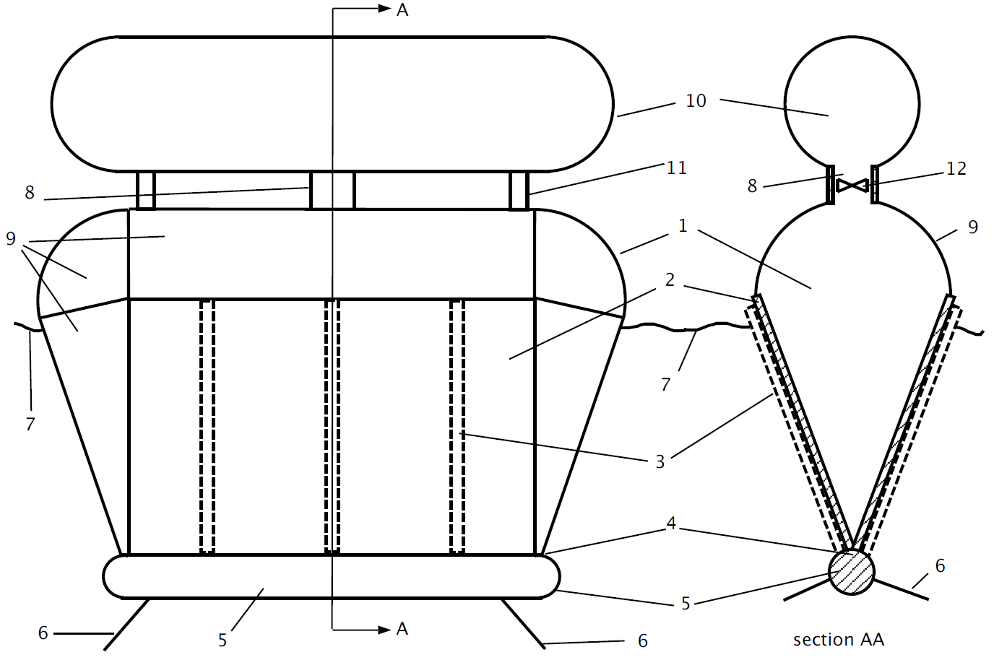
Free-floating Clam: “It shrinks as it sinks”
(Farley, EWTEC 2011)

Slide 9
Floating air bag

Slide 10
Flexible bag as underwater compressed air energy storage
(Pimm et al., 2014)

Slide 11
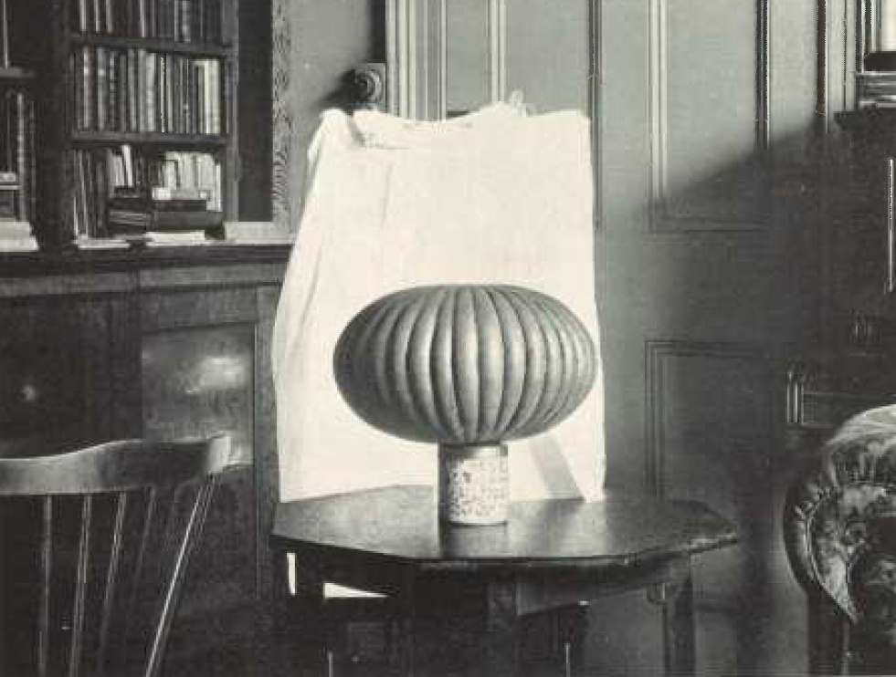
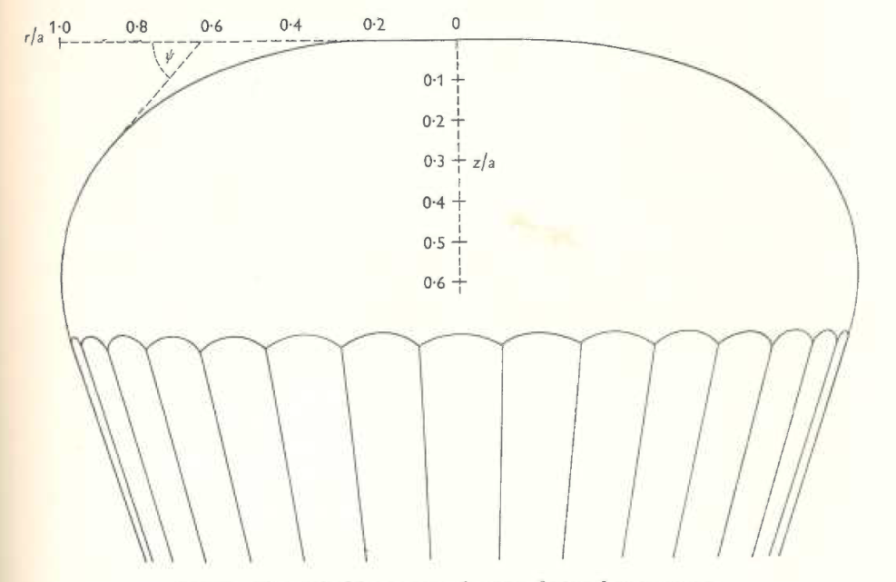
Assumptions:
Tendons are inextensible
Tension is carried by the tendons only
(G. I. Taylor, On the shapes of parachutes, 1919)

Slide 12
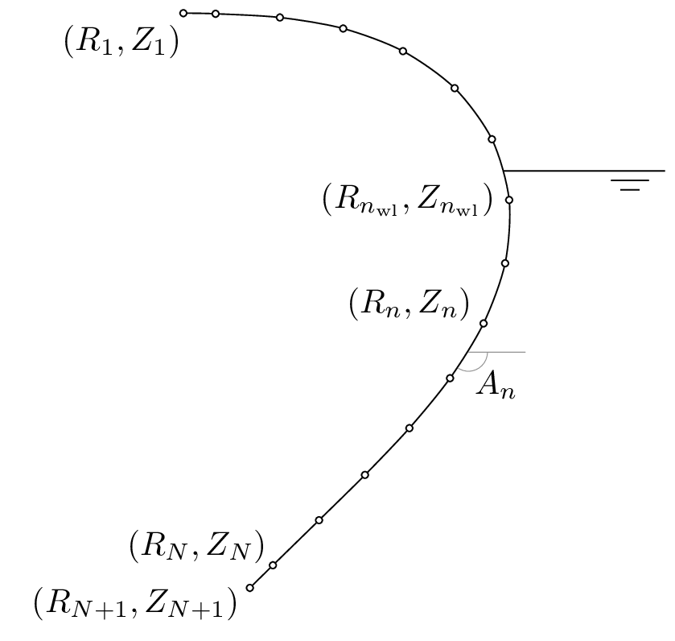
Static shape calculation

Slide 13
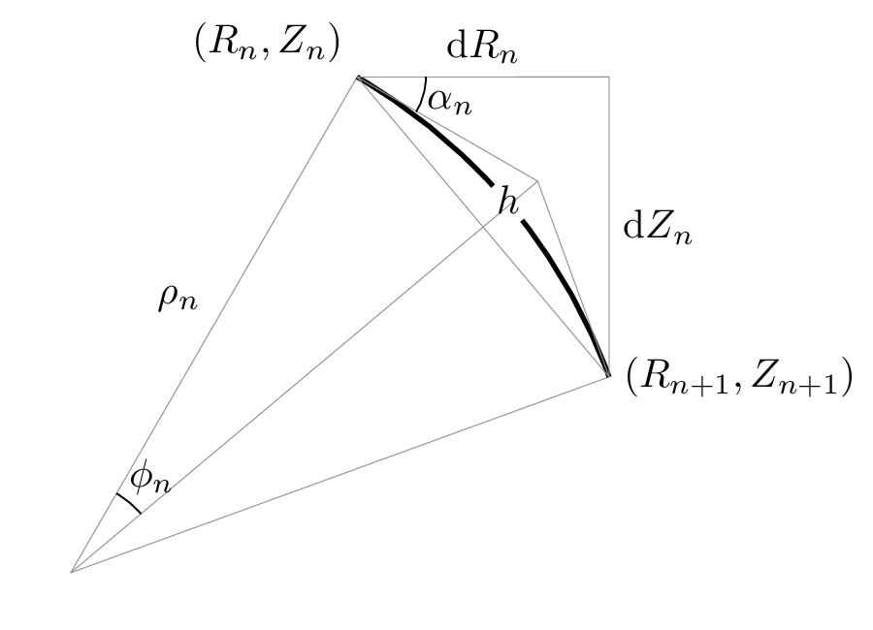
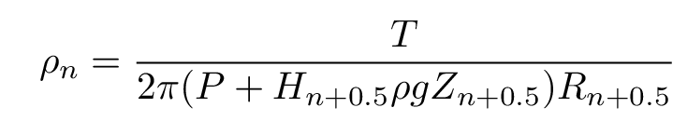
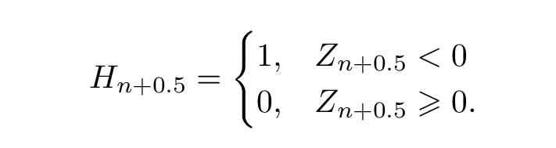

Slide 14
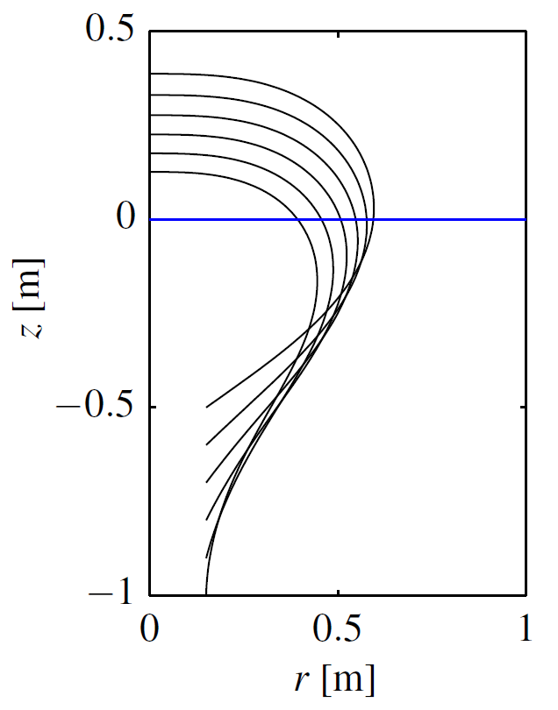
Calculated shapes for
given tendon length and internal pressure, and different bottom submergences

Slide 15
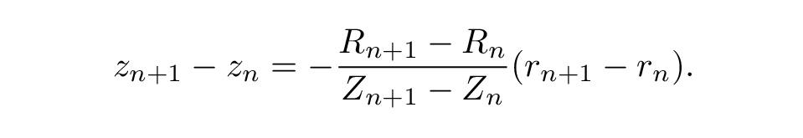

Dynamic model
For each element of the tendon:
For the substructure:
Assumptions:
No change in element length
Conservation of air mass throughout the system
Gives relationship between pressure amplitude and volume amplitude
Mean absorbed power:

Slide 16
Hydrodynamic pressure/force
Hydrodynamic pressure on each tendon element:
Hydrodynamic force on the substructure:
Wave radiation forces are expressed in terms of added mass and damping:

Slide 17
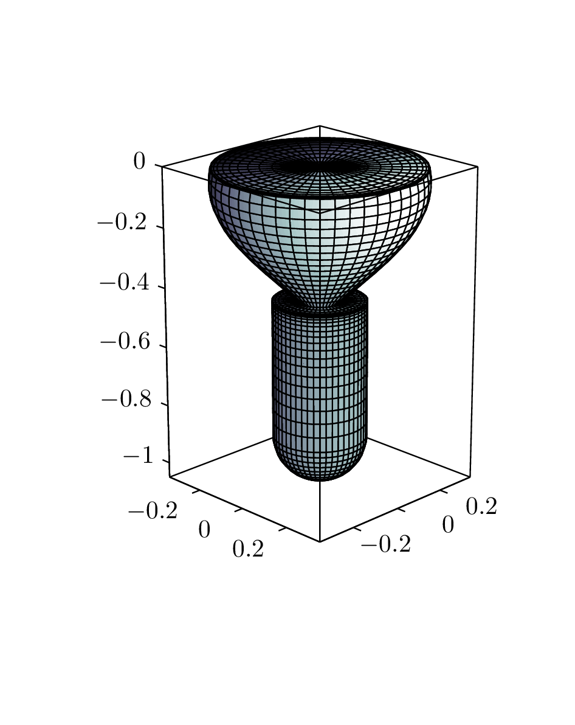
Typical panel model

Slide 18
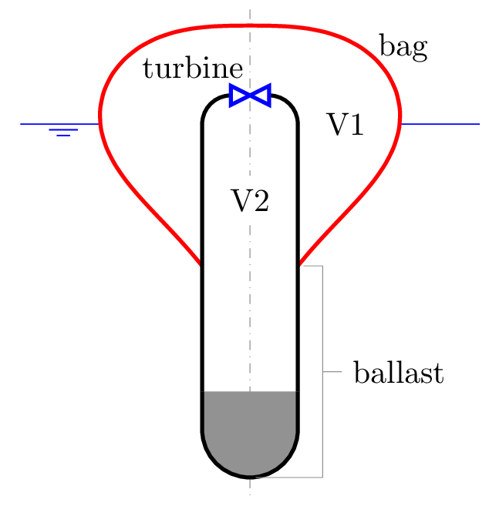
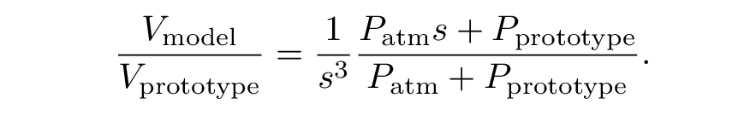
Model tests: Scaling of air volumes

Slide 19
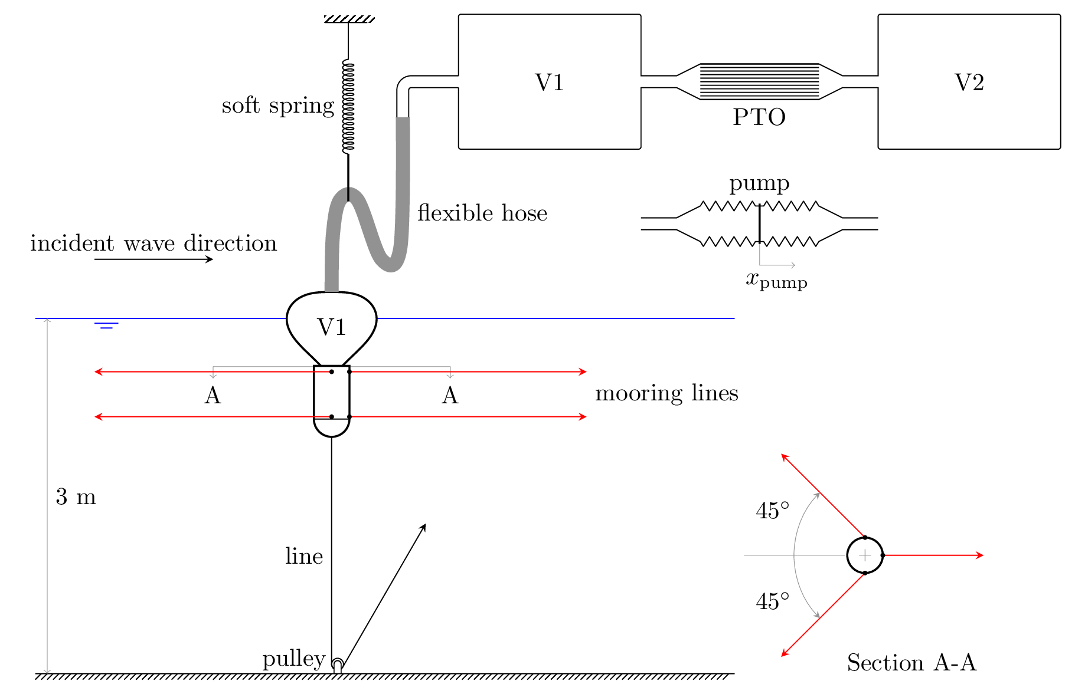
Model test setup

Slide 20
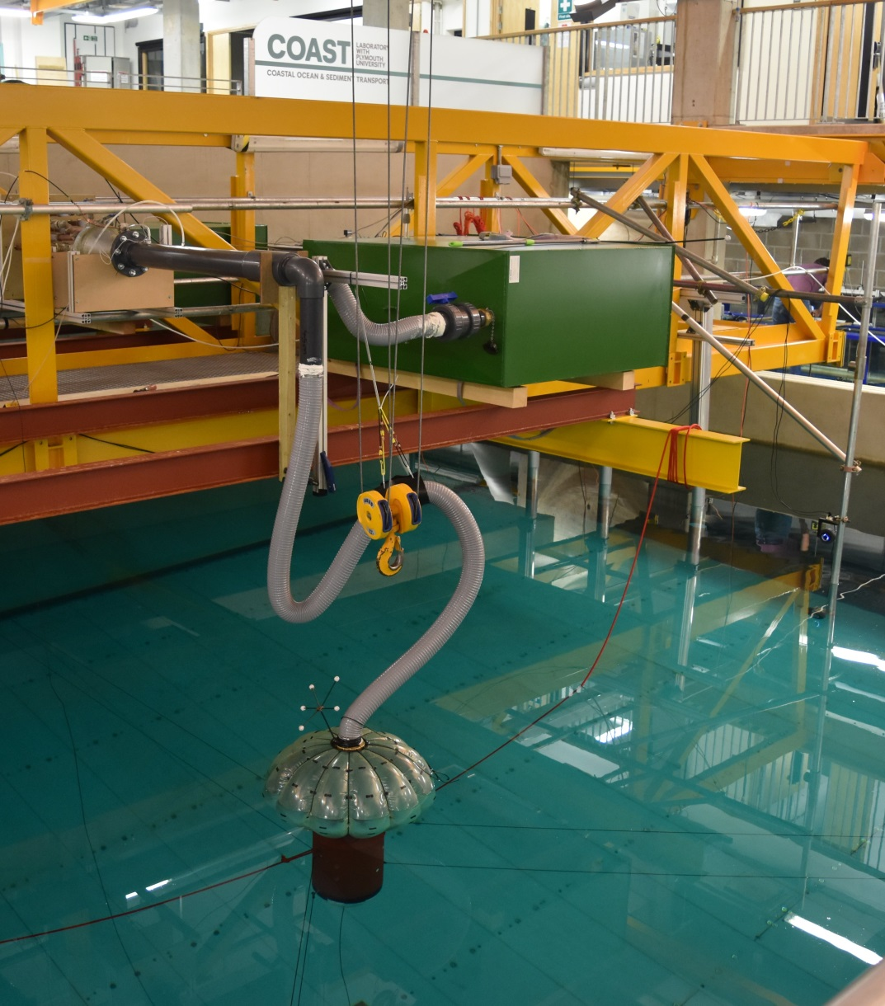
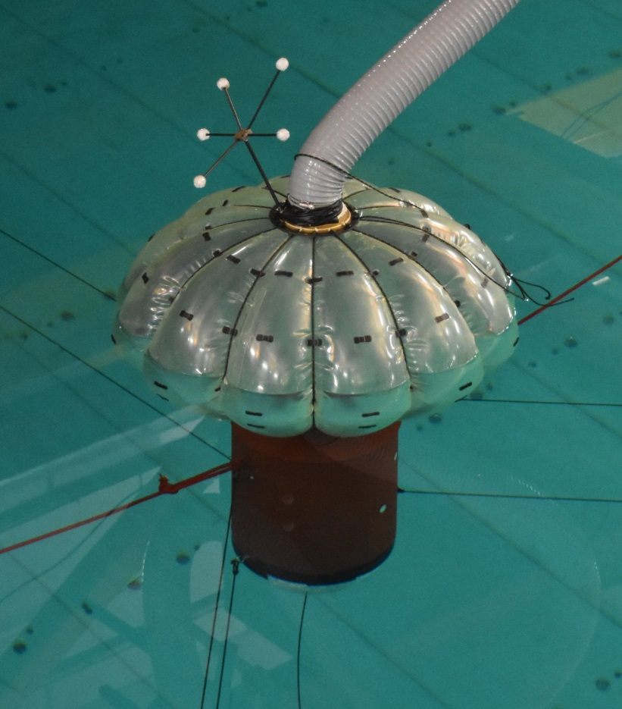
PTO
V1

Slide 21
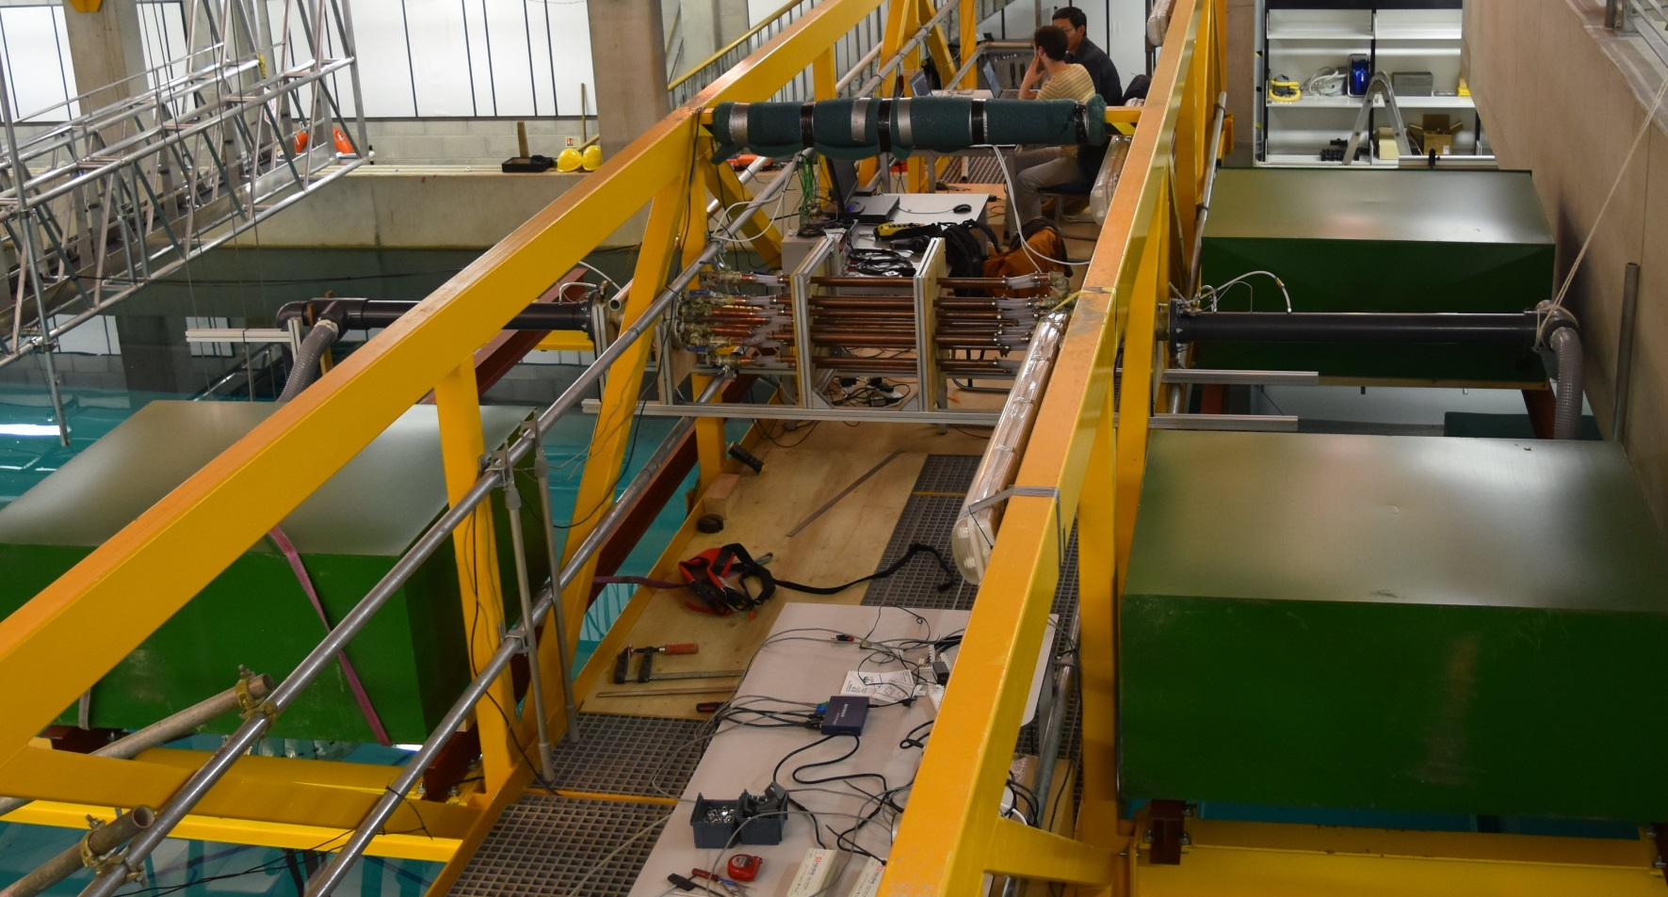
PTO
V2
V1

Slide 22
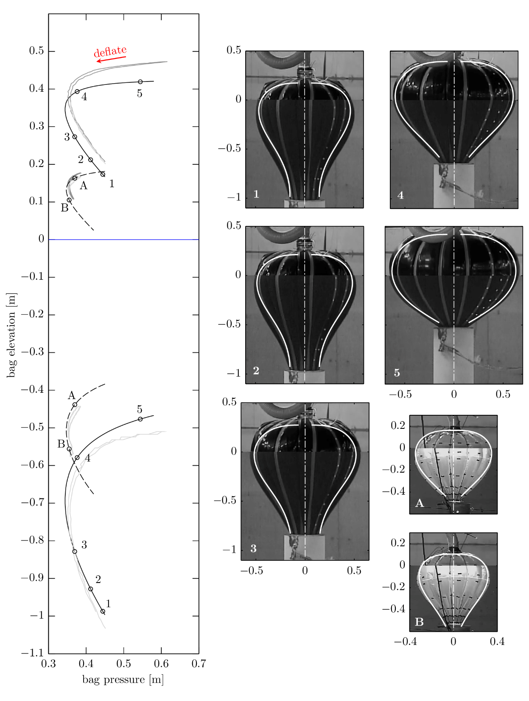

Slide 23
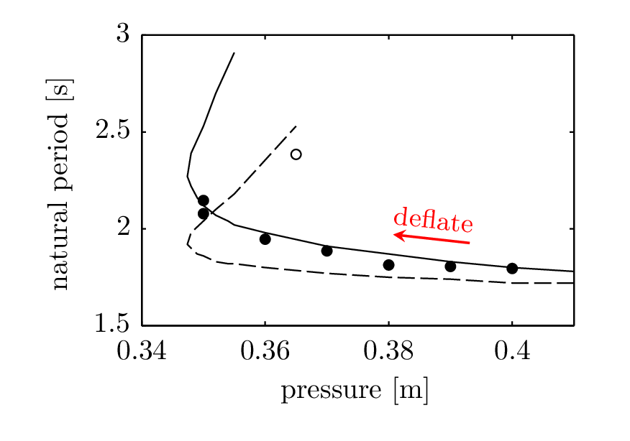
The natural period varies with the amount of air in the system

Slide 24
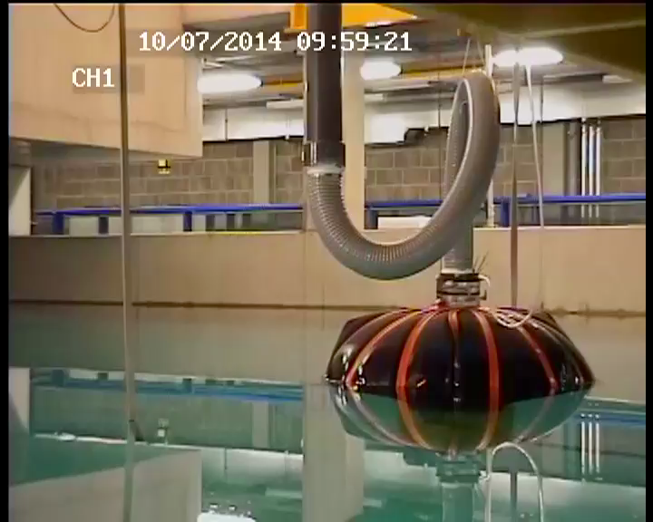
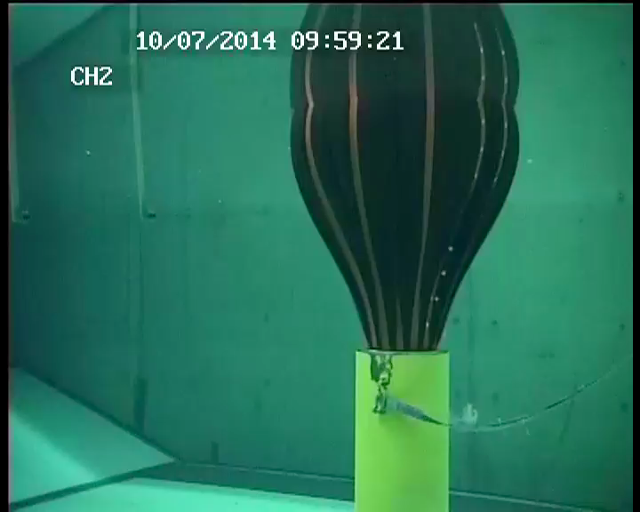
Case 2

Slide 25
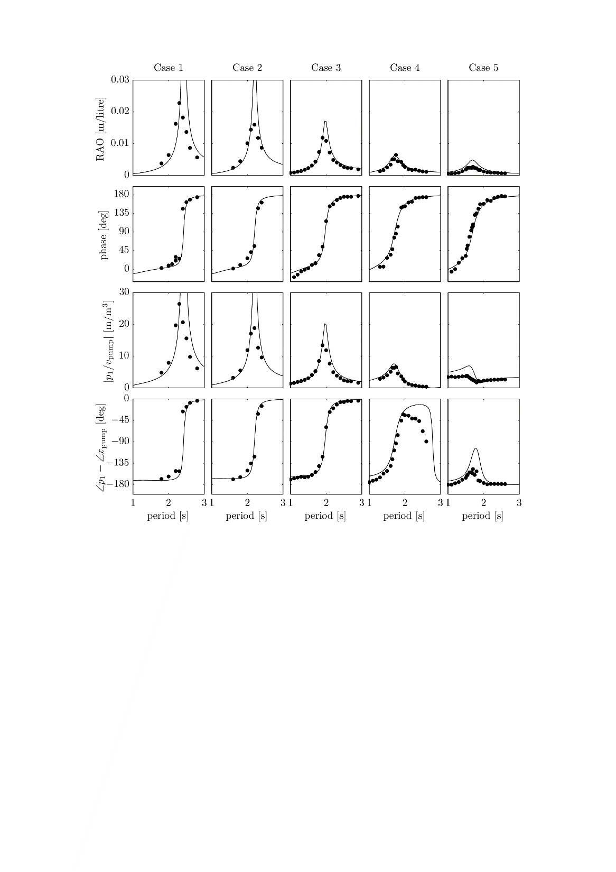
Pumped oscillation results

Slide 26
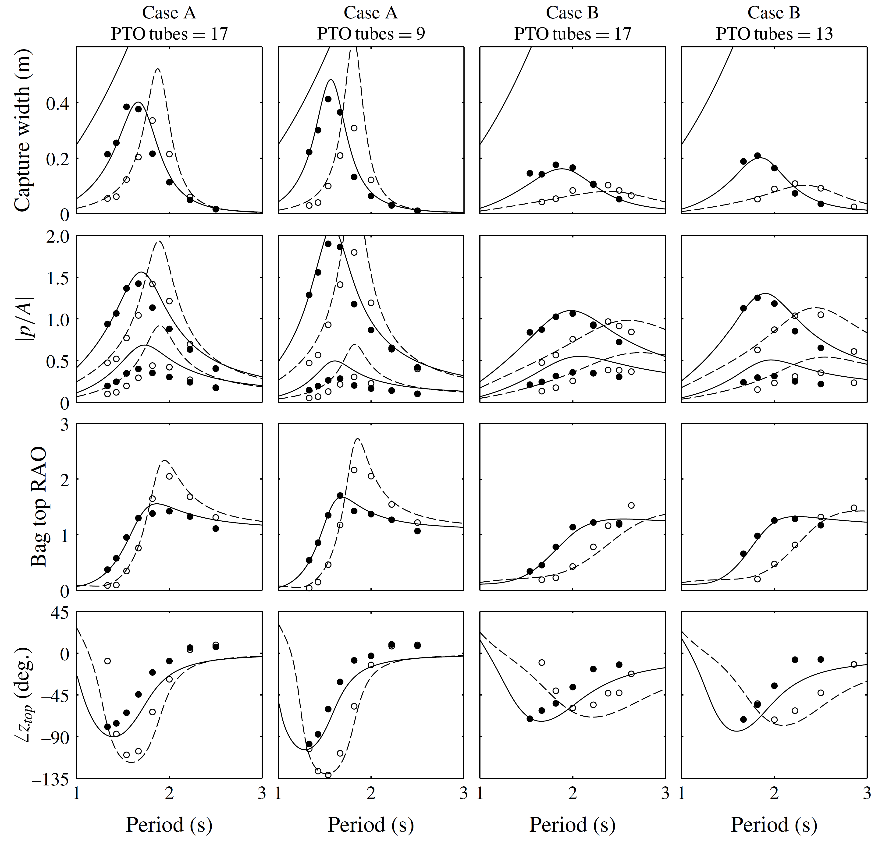
Incident wave results

Slide 27
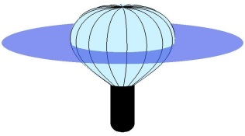
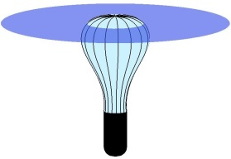
Relative capture widths at various internal pressures

Slide 28
Comparison with a rigid body of the same geometry

Slide 29
Submerged bag and rigid float

Slide 31
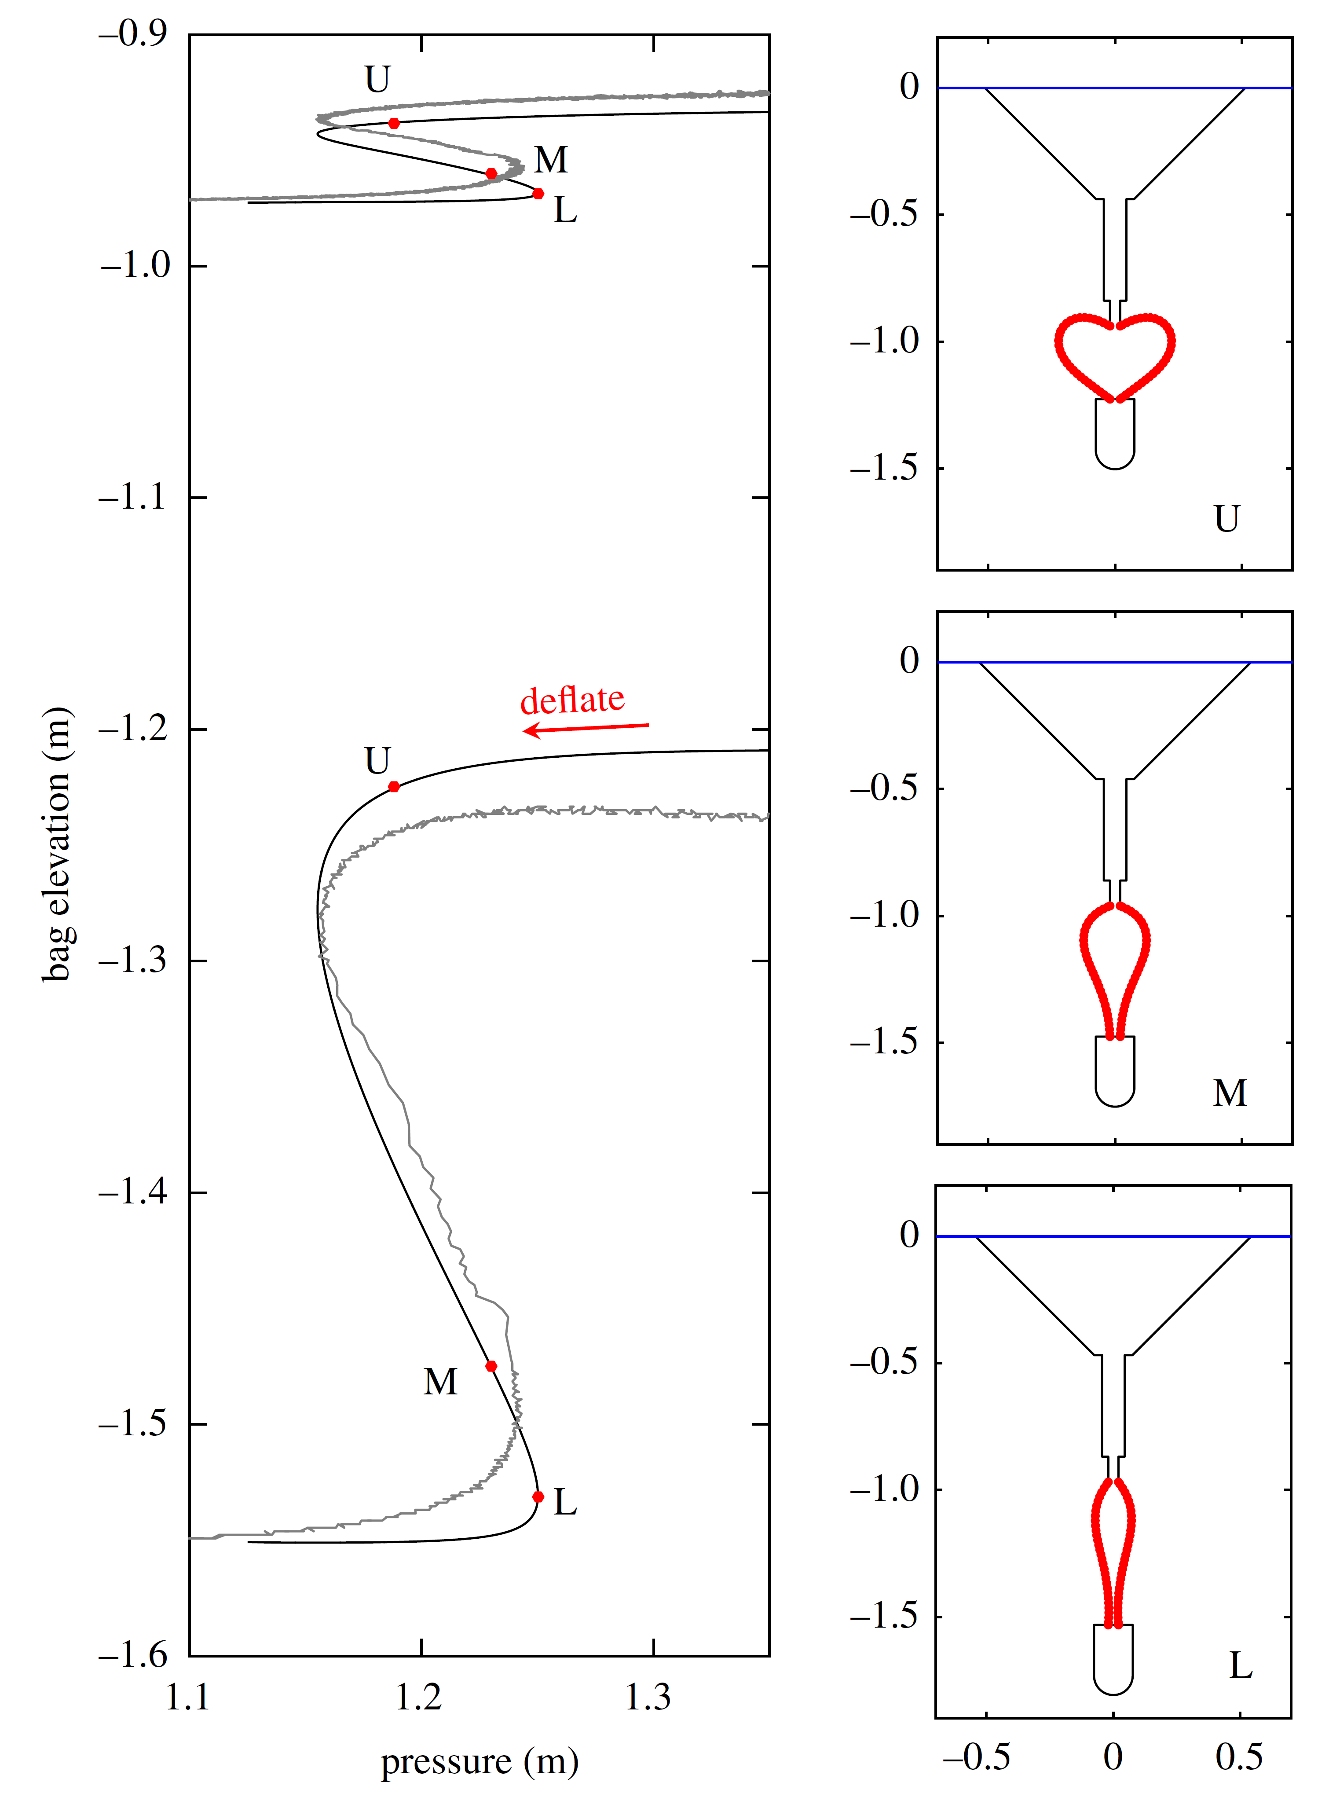

Slide 32
Natural period of bottom cylinder
with float fixed

Slide 34
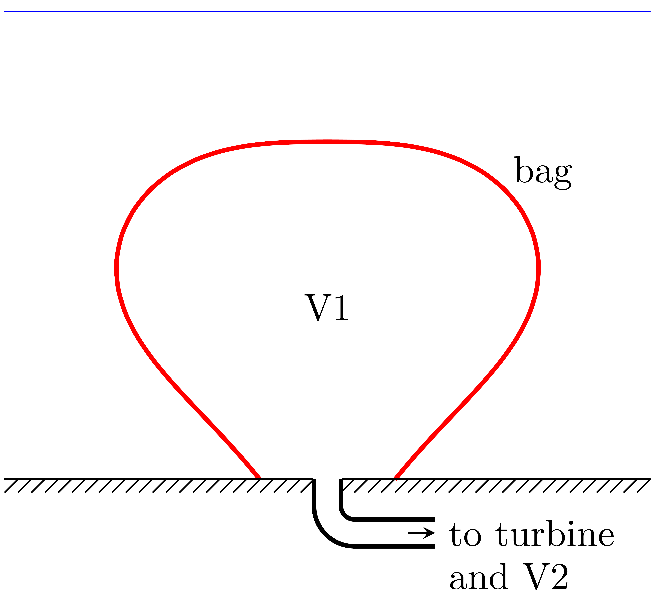
Submerged bag fixed to the sea bed

Slide 35
Comparison

Slide 36
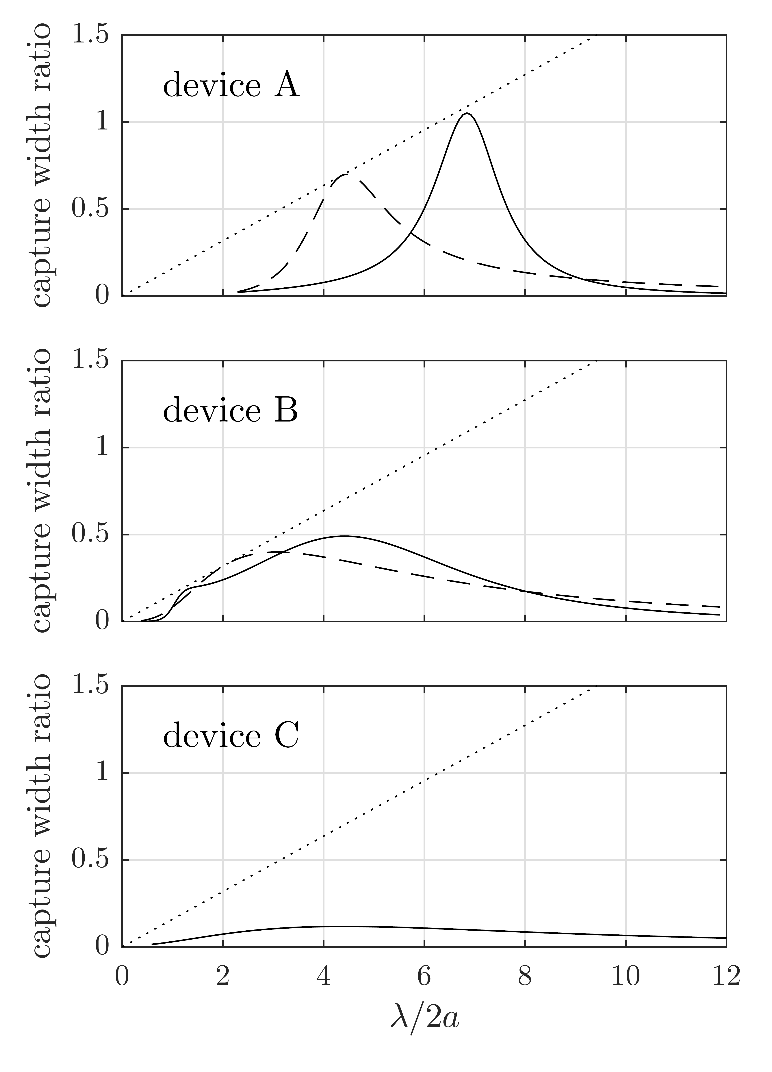

Slide 37
Thank you

